Slide 1
Finite Automata

Slide 2
Finite Automaton
Input
String
Output
“Accept”
or
“Reject”
Finite
Automaton

Slide 3









Transition Graph
initial
state
accepting
state
transition
state

Slide 4
Initial Configuration
Input String

Slide 5
Reading the Input

Slide 9
Input finished
accept

Slide 10
Rejection

Slide 14
Input finished
reject

Slide 15

Another Rejection

Slide 16
reject

Slide 17
Another Example

Slide 21
Input finished
accept

Slide 22
Rejection Example

Slide 26
Input finished
reject

Slide 27

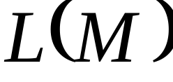

Languages Accepted by FAs
FA
Definition:
  The language contains
  all input strings accepted by
  = { strings that bring
  to an accepting state}

Slide 28
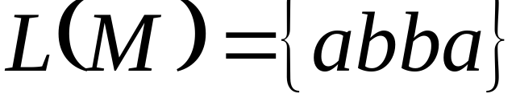
Example
accept

Slide 29
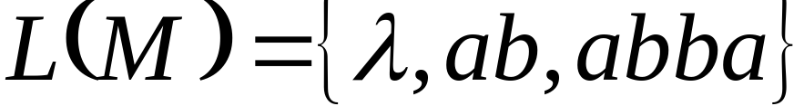
Example
accept
accept
accept

Slide 30
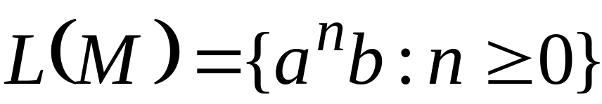
Example
accept
trap state

Slide 31
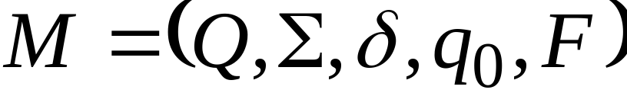




Language Accepted by FAs
For a FA
Language accepted by :

Slide 32

Observation
Language rejected by :

Slide 33

Example
= { all strings with prefix }
accept

Slide 34






Example
= { all strings without
substring }

Slide 35
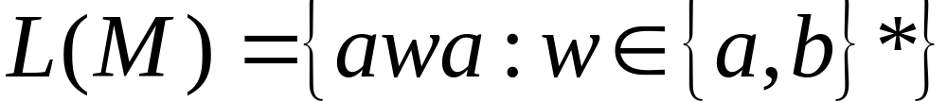
Example

Slide 36

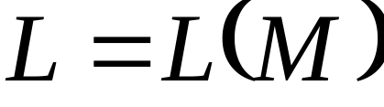
Regular Languages
Definition:
A language is regular if there is
FA such that
Observation:
All languages accepted by FAs
form the family of regular languages

Slide 37
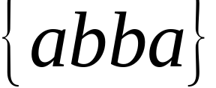
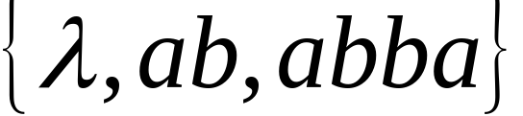

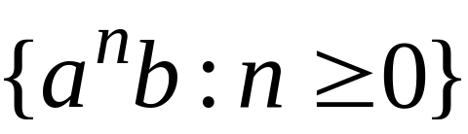
Examples of regular languages:
{ all strings with prefix }
{ all strings without substring }
There exist automata that accept these
Languages (see previous slides).

Slide 38
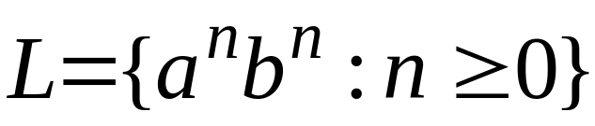
There exist languages which are not Regular:
Example:
There is no FA that accepts such a language
(we will prove this later in the class)

